Slide 1
Transgender day of remembrance November 20
Student health & human services
Office of human relations, diversity & equity
July 2022

Slide 2
If you won $3 million lottery, what would you do with the money?

Slide 3
Objectives
Learn about Transgender Day of Remembrance
1
Discuss the importance of the day
2
Identify ways to create change
3

Slide 4
What does it mean to be transgender?
This term refers to someone whose gender identity or expression differs from the gender identified at birth

Slide 5
What is transgender day of remembrance?

Slide 6
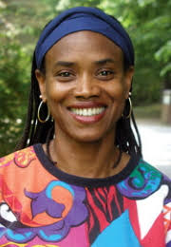
Transgender Day of Remembrance began as a vigil to honor Rita Hester, a transgender woman who was killed in 1998.
The vigil commemorated all the transgender people lost to violence since Rita's death and began an important tradition.
Transgender Day of Remembrance is held every November 20th
1963 - 1998

Slide 7
Notes:
https://www.youtube.com/watch?v=a_Xczm8Wt0Y
5:04

Slide 8
Reflect
Had you ever heard about transgender day of remembrance before?
What is something in the video that stood out to you?
do you think that Transgender day of remembrance is important?

Slide 9
Just listen
Notes:
Teacher – focus on the importance and value of listening to the voices of those who are “different” from us. we become richer by understanding others’ stories.
https://youtu.be/zo4Lh1yP50Q
3:15

Slide 10
Trevor Noah & angelica emphasized the need to listen.
What do you think listening does?
How can listening create change?
Notes:
This can be discussed or can be made as an assignment to turn in later.

Slide 11
What is a message you would like everyone to hear?

Slide 12
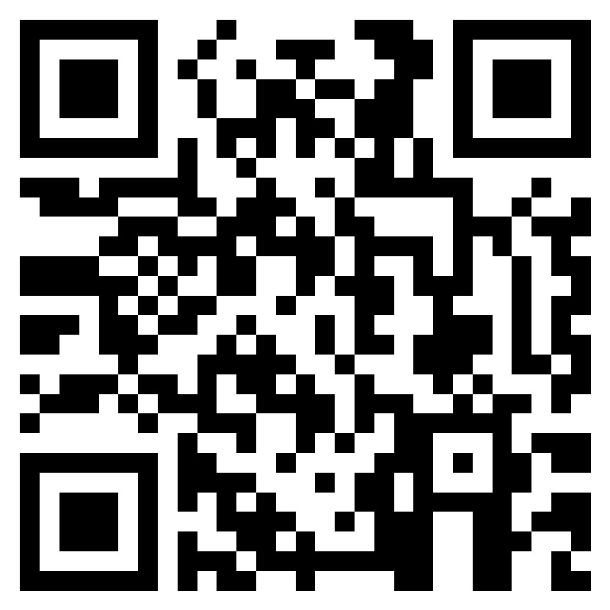
Teacher Feedback
Notes:
Teacher, please complete a brief feedback survey by scanning the QR code or using the link below
https://forms.office.com/r/i9UqyyxzTT

Slide 13
Human relations, diversity & Equity

